Slide 1
Conley
Kindergarten
Curriculum Presentation

Slide 2
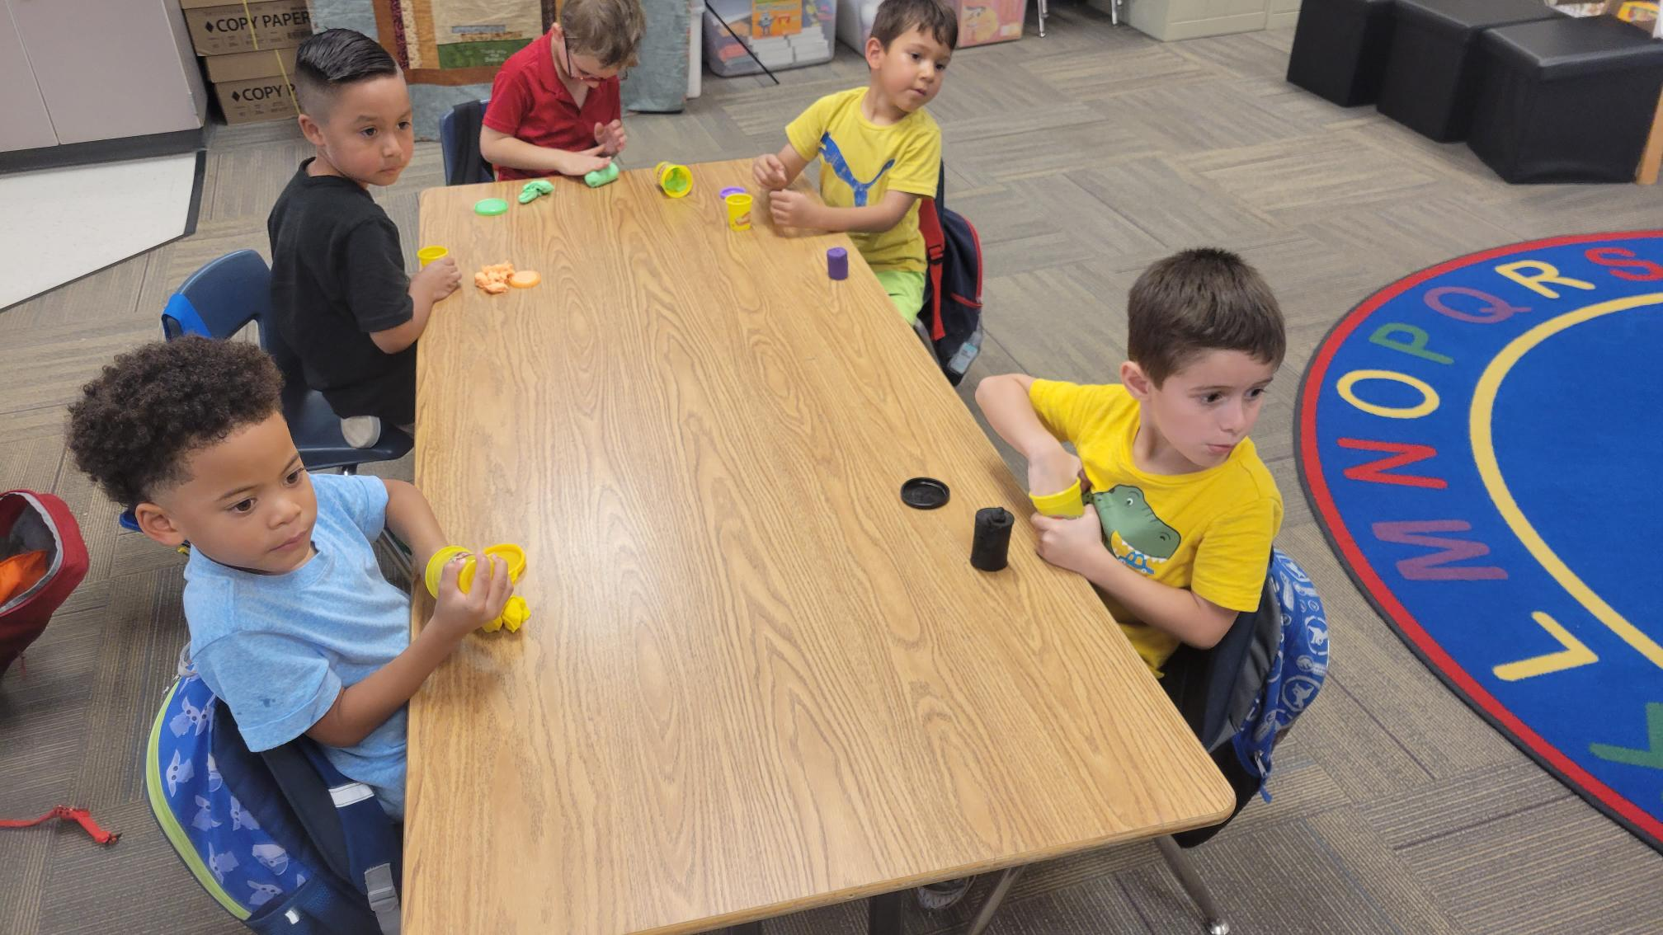
Fun in learning

Slide 3
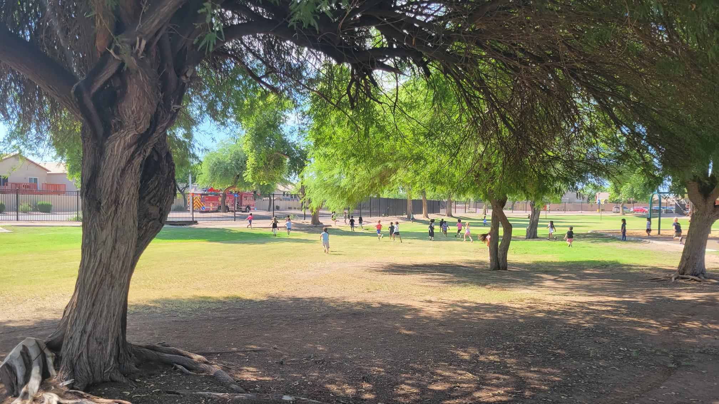
Fun outdoors

Slide 4
Language Arts
OBJECTIVES:
Mastery of letters and sounds
Mastery of writing letters
Mastery identifying words and sentences
Speak in complete sentences
Write in complete sentences
Identify the parts of a book
Reading books for pleasure and knowledge
Link to Language Arts Standards
http://www.cusd80.com/cms/lib6/AZ01001175/Centricity/Domain/4554/ELA_K-2nd_blueprints.pdf

Slide 5
Math
OBJECTIVES:
Mastery of counting, writing, grouping and comparing numbers to 20.
Addition and subtraction mastery to 5
  I do introduce them to problems up to 10.
Solving word problems using multiple strategies
Count to 100 by 1’s and 10’s.
Mastery of shapes, colors, days of the week, months of the year
Link to Math Standards:
http://www.cusd80.com/cms/lib6/AZ01001175/Centricity/Domain/4550/math_K_blueprints.pdf

Slide 6
Science
KINDERGARTEN STUDENTS WILL:
Conduct experiments
Make observations
Record data
Draw conclusions
Once every 6 day rotation, students will have a 50 minute block of time in STEM/Technology lab with Mrs. Kienitz. This is an additional opportunity for exploration of kindergarten science topics, experimenting, and so on.

Slide 7

Social and Emotional
Our school will be implementing the Second Step curriculum to help all elementary children develop social and emotional skills.
Goals:
Promote Social Emotional skills
Positive classroom behavior
Academic Achievement
Age-appropriate weekly lessons taught in all classrooms at all grade levels.

Slide 8
Calendar
KINDERGARTEN STUDENTS WILL:
Develop skills in math, reading, and writing
Learn the days of the week, months of the year, and today’s date
Foster responsibility and community through active student participation

Slide 9

Behavior Expectations
KINDERGARTEN STUDENTS WILL:
Behave in a way that promotes learning
Walk across our campus quietly, with hands to self, and eyes forward
Listen to teachers, students, and guests
Understand school and classroom rules and consequences - Clip Chart
Demonstrate good character
and citizenship

Slide 10
Homework
Homework: A weekly homework packet will go home on Mondays. Homework will be due the following Friday. Please help your child to be responsible for their folder and homework.
Have your child do their work as an established routine. Please do NOT give them answers. We are trying to instill independence, so read them the instructions and then let them try to do the work by themselves.

Slide 11

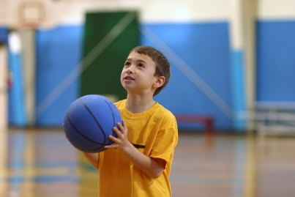
Specials
Our specials are P.E. (x2), Music (x2), Library, and STEM/Technology Lab.
We have a six-day rotation for each special. The specials for the month are on a paper calendar I have already provided to you.
Students are expected to behave and follow all directions while at their special classes.

Slide 12
Snack Time
Each afternoon our Kinders are allowed to eat snack. This is something you can provide for your student each day.
SNACKS MUST BE HEALTHY.
  No candy, chips (doritos, Cheetos etc)
  Veggie straws, cheeze-its are fine!
Please make sure to pack a water bottle for you student every day!

Slide 13

Lunch
Students may bring a lunch from home or receive a lunch from school.
SCHOOL LUNCHES MUST BE BOUGHT!
  E-mail sent out to parents within the past week.
After 20 minutes, in the cafeteria, students have a 20 minute recess outside.

Slide 14
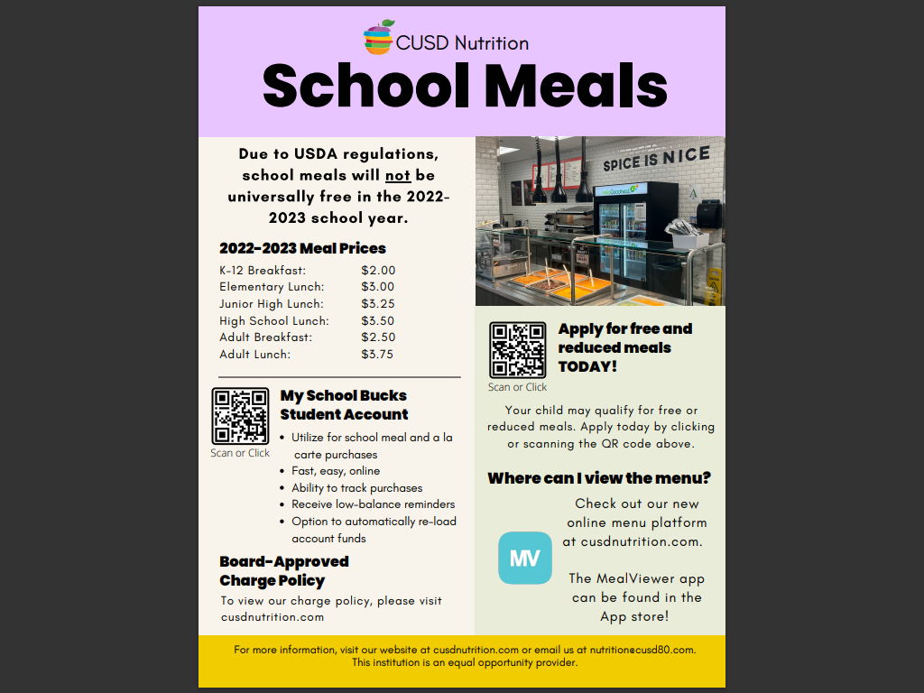

Slide 15
Conferences
We have teacher/parent conferences twice a year: at the end of August and the middle of February
Additional conferences will be scheduled in advance with the teacher if needed.

Slide 16
Report Cards
Kindergarteners progress is identified with the following indicators: Mastery (M), Progressing (P), or Area of Concern (AC).

Slide 17
Afternoon Pickup Procedures
If picking your child up in a car, make sure to have the purple sign on the review mirror for an easier pick-up. Please stay in your car.
If you wish to personally pick them up from underneath the ramada, please park in the parking lot.
Remember, kindergarten dismissal is 2:45!!

Slide 18
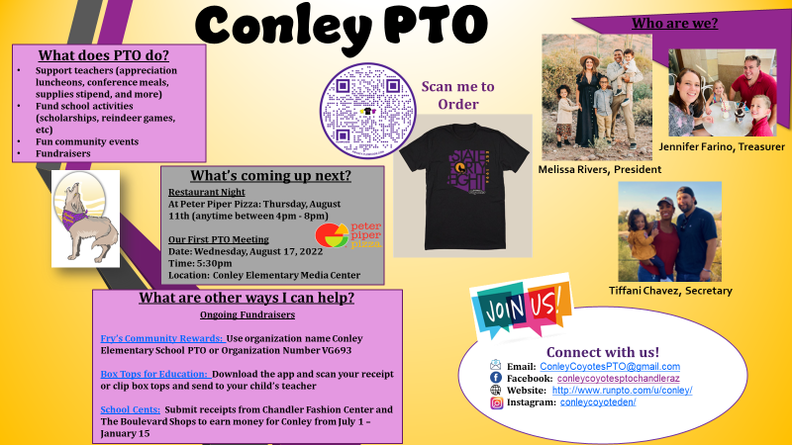

Slide 19


Slide 20

Thank you for attending.
I am happy to address any further questions about general kindergarten topics.
If you have a specific question regarding your child, please fill out a slip by the door and I will contact you later this week.

